Slide 1
MCTV CA1
Boomtown rats - Group Presentation

Slide 2
Company introduction
Family run business located in Limerick City, owned by Michael and Doreen Cooney.
5 staff members and 4 are part of the family, Derek the eldest son, Roberta and twin brothers Mark & Liam. The other staff member is a part time shop assistant.
Small retail company selling TV’s and TV equipment.

Slide 3
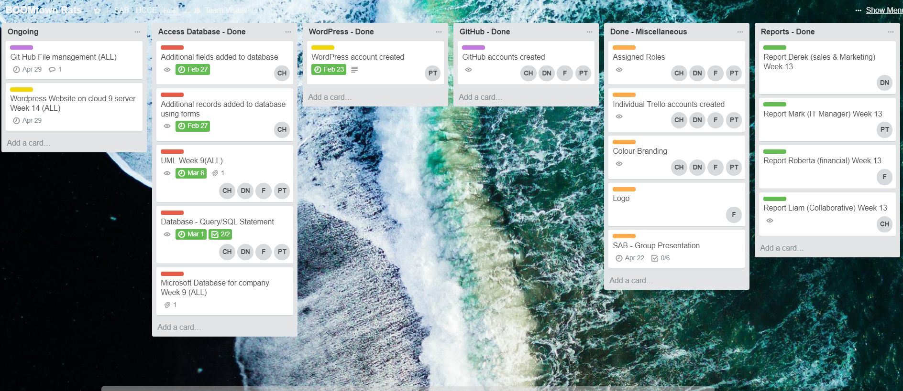
Task breakdown

Slide 4
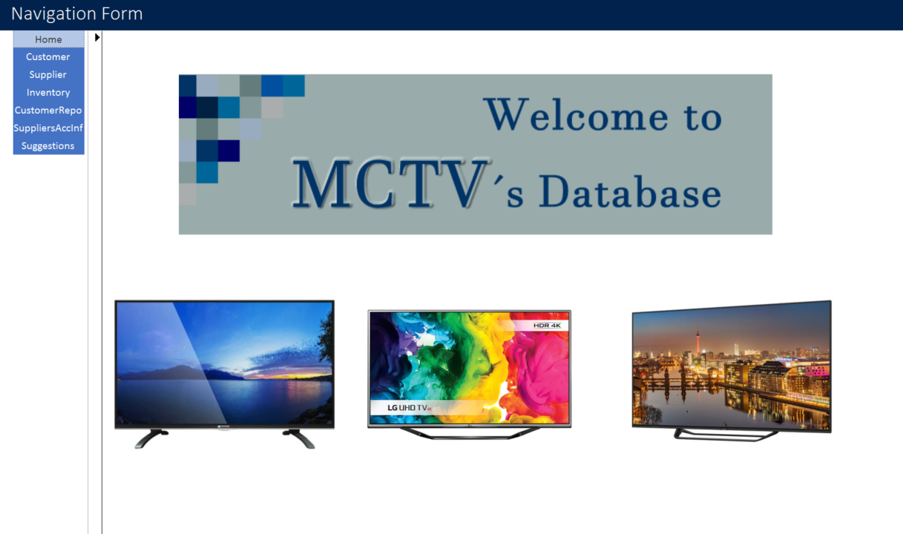
Access Database

Slide 5
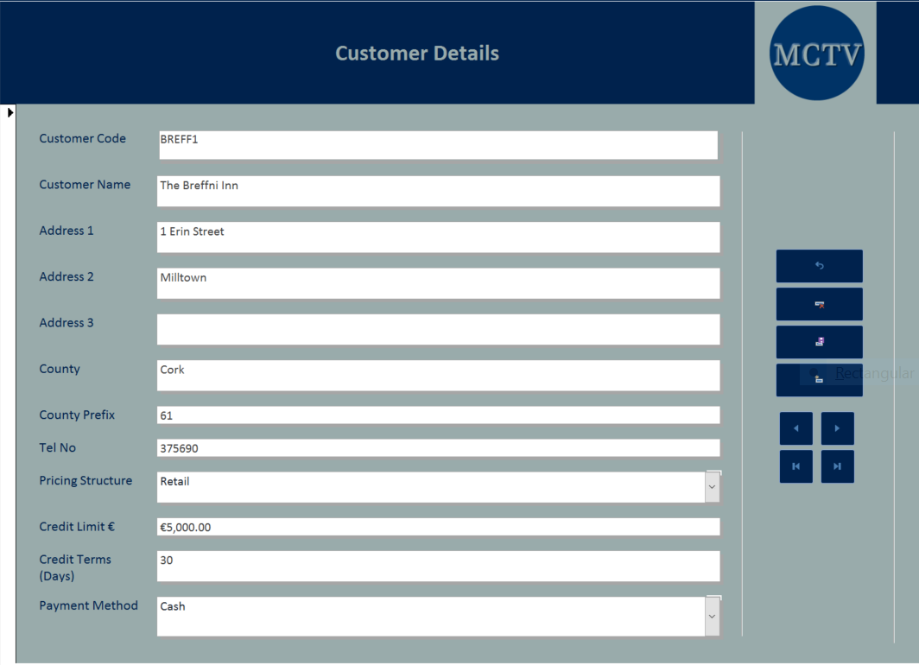
Customer report form used for quick entry of customer details.
Company colour and branding used.

Slide 6
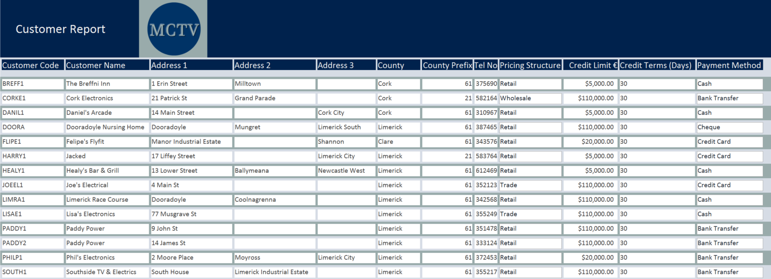
Customer report produced using access database.

Slide 7
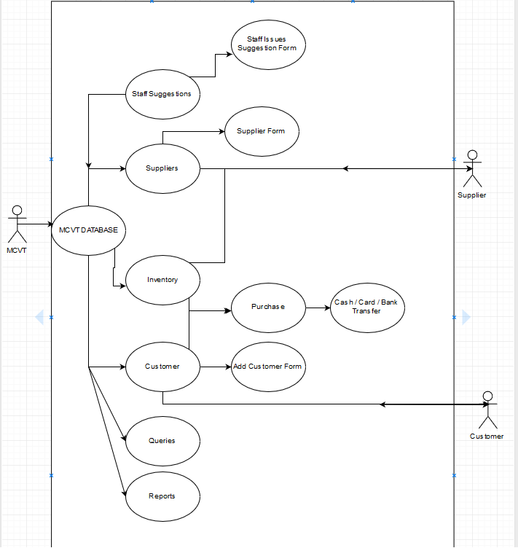
Uml
UML diagram based on the Access Database

Slide 8
Individual user guides

Slide 9
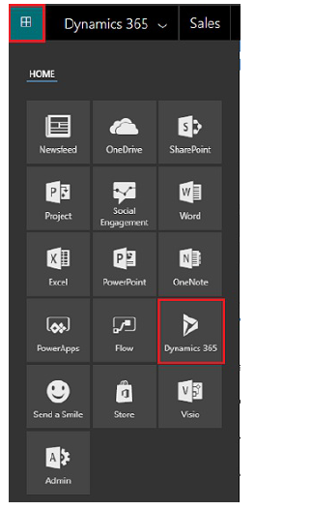
Derek – crm software
CRM is an approach to manage a company's interaction with customers.
CRM is driving sales growth as much as 27%.
With CRM, the company owns the single best tool for customer success—accurate information.

Slide 10
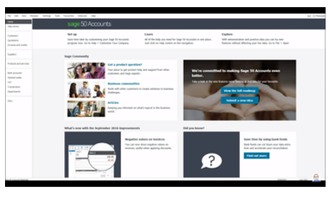
Roberta – Financial software
Why Sage 50?
On-the-go accounting
Integration
Competitors
FreshBooks, QuickBooks and Xero

Slide 11
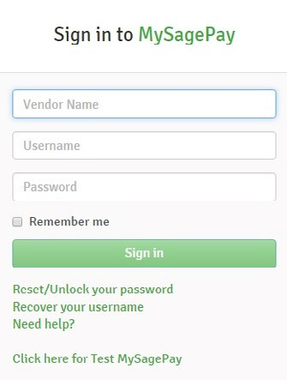
Mark – Online payments
SagePay
Oline & in store Payments
Invoice payments
Fraud Prevention
Reports

Slide 12
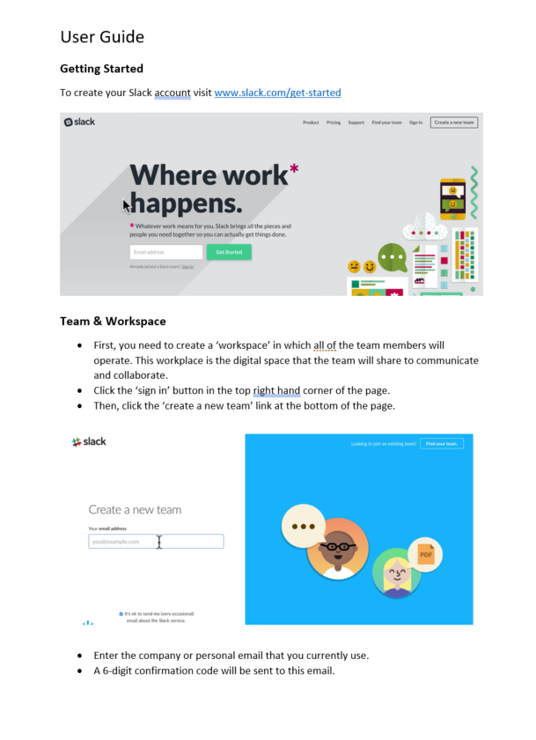
Liam – collaborative software
Slack is a digital workspace facilitated by cloud computing technology
It is available as a desktop and mobile application.
There are 3 different plans available; Free, Standard & Plus.
Allows for integration with certain 3rd party apps or services.

Slide 13


Colour Scheme & branding
We used trial and error to test suitable colour schemes for our company branding.
We wanted to choose something that would transfer well to our database and our website.

Slide 14
Conclusion
After reviewing all of our individual software reports, we conclude that MCTV can incorporate all of the presented applications into the company’s operation.
As all of the applications are facilitated by the cloud, there is no need for large investment in traditional hardware or software components.
As a result MCTV can re-invest the majority of the €100,000 in other aspects of the company.
We would suggest expanding the business operation to other parts of the country, maybe in the Leinster region so we can access the Dublin market.

